Slide 1


Streaming Your Data
Options in the wild
By -: Palash Chatterjee & Atif Akhtar

Slide 2
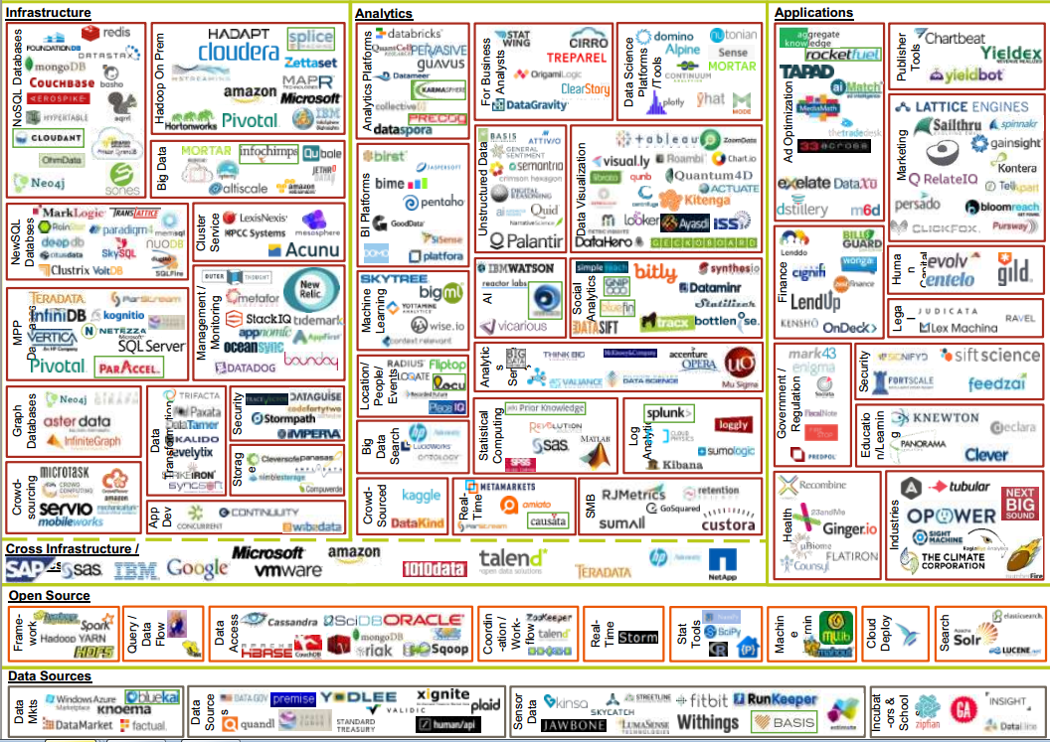
Current Landscape

Slide 3
Data Stream
Abstraction representing and unbounded data set - one that is infinite in its definition and ever growing. Ordered and immutable in nature.

Slide 4



What are the different types of options available out there?
Micro-batching
Near real time processing
Real time processing

Slide 5
Stream Processing
Event Stream
Transformation F(x)
Transformation G(x)
Input Stream
Output Stream

Slide 6
Things to keep in mind
Time
Event time
Log append time
Processing time
State
Local or internal state
External state
Processing Time Window
Restartability/Fault tolerance and Reprocessing
Out of sequence events
Notes:
Over to my colleague Palash with the demos

Slide 7






Use Cases for Streaming
Stock Market Analysis
IoT
Log Monitoring
Business Analysis
Complex Event Processing
Clickstream Analysis
Notes:
Over to my colleague Palash with the demos

Slide 8

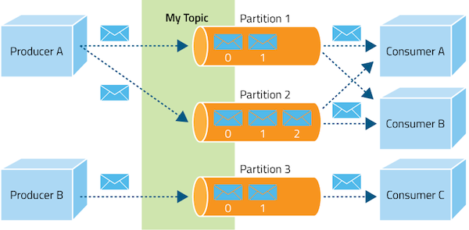
Kafka
Notes:
Over to my colleague Palash with the demos

Slide 9

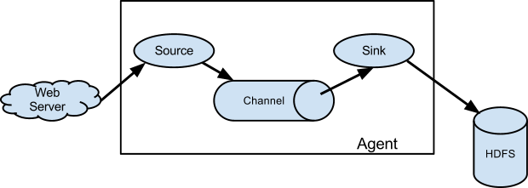
Flume
Notes:
Over to my colleague Palash with the demos

Slide 10
Flume vs. Kafka
FLUME | KAFKA
Meant to collect data and put in one place (HDFS or HBase) - Built for Hadoop | General purpose - highly Scalable PUB Sub
Push | Pull - Handles spikes very well
Not dynamically scalable | Can add more Pub/Sub without restarting
Has more connectors | Has better community - Has connectors now
No guarantee about order of delivery | Order of delivery preserved within a partition
Notes:
Over to my colleague Palash with the demos

Slide 11

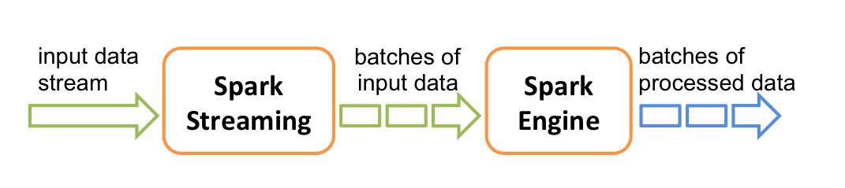
Spark Streaming

Slide 12
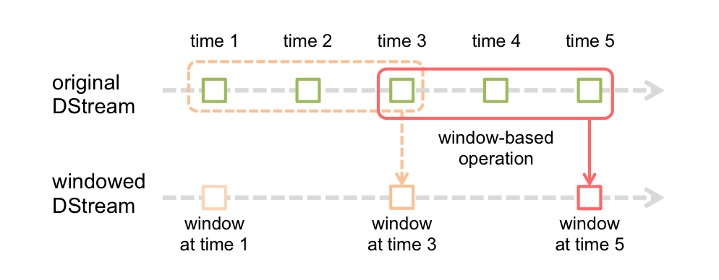
Spark Streaming

Slide 13


Spark Streaming
Windowed micro batching
Highly Scalable and Dynamic
Huge community and well tested
Huge library for ML/SQL/Analytics
Lot of third party tools directly integrate
No support for per event streaming
Very difficult to handle out of batch events
Micro batching introduces latency

Slide 14

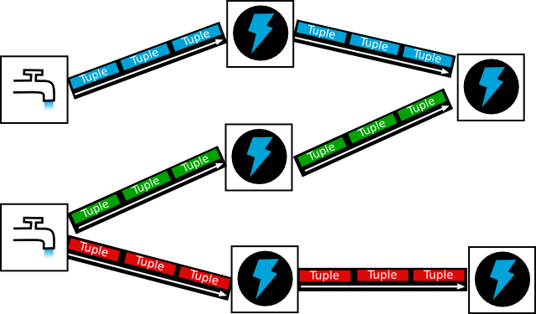
Storm

Slide 15
Storm/Heron
Near real time processing [micro-batching using Trident]
No single point of failure
At-least-once processing guarantee [exactly-once using Trident]
Windowing support [using Trident]
Little community support
Not tied to Hadoop

Slide 16

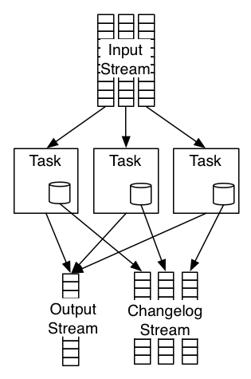
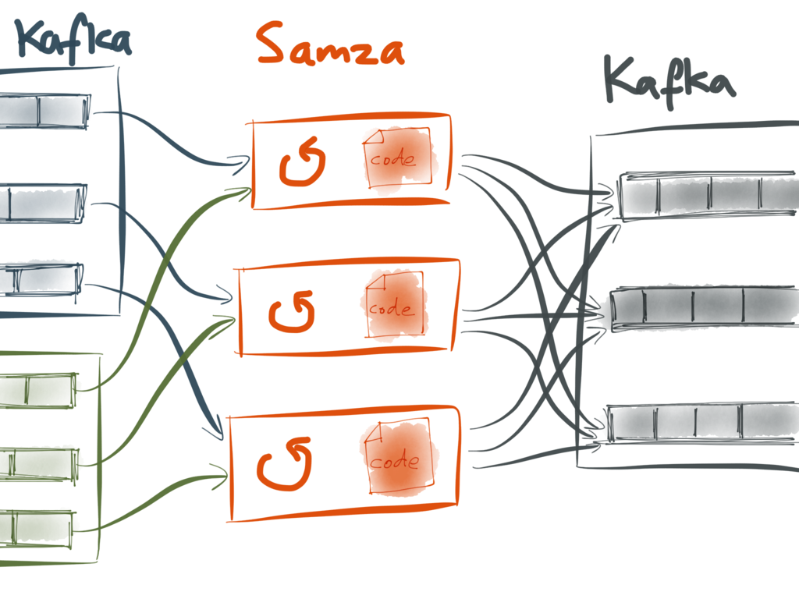
Apache Samza

Slide 17
Apache Samza
Performs near real time - per event processing
Works on top of YARN
Lot of connectors for Hadoop tools
Stateful
Tied into Hadoop
Topologies cannot be connected - everything needs to be written to Kafka
Fairly new and very small community
JVM Language only

Slide 18
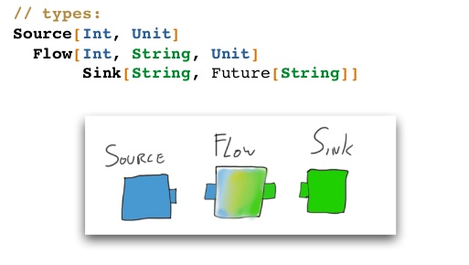
Akka Streams

Slide 19
Akka Streams
val fetchLinks: Flow[String, Link, Unit] =
Flow[String]
.via(throttle(redditAPIRate))
.mapAsyncUnordered( subreddit => RedditAPI.popularLinks(subreddit) )

Slide 20
Akka Streams
Performs near real time - per event processing
Built with the use case of handling backpressure over single nodes.Reactive backpressure handling
Handles backpressure efficiently up to the OS level
Being used internally by the latest version of Spark Streaming to boost performance
Not an alternative to Spark
Have to follow and respect Actor pattern everywhere

Slide 21
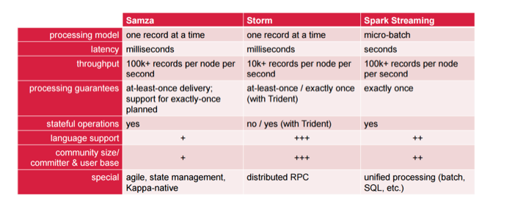
At a glance
Source : https://mapr.com/blog/stream-processing-everywhere-what-use/

Slide 22
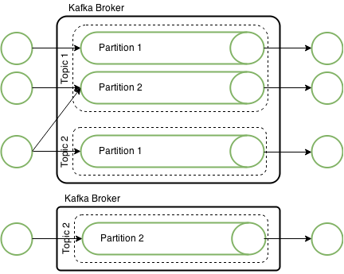

Use Case - Real Time Image Tagging

Slide 23
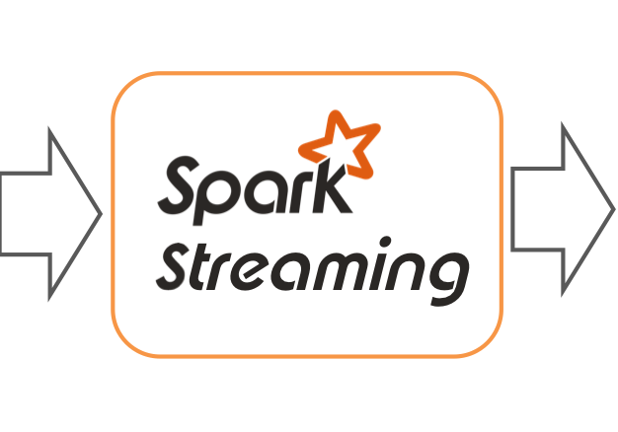


Use Case - Product And Per Interval Trends
Reporting

Slide 24
References and Good Reads
1.http://milinda.pathirage.org/kappa-architecture.com/
2.https://www.safaribooksonline.com/library/view/kafka-the-definitive/9781491936153/
3.https://www.youtube.com/results?search_query=reactive+streams+akka
4.https://en.wikipedia.org/wiki/Lambda_architecture
5.https://stackoverflow.com/questions/29111549/where-do-apache-samza-and-apache-storm-differ-in-their-use-cases

Slide 25

QUESTIONS

Slide 26
THANK YOU

